Slide 1
Shiver me timbers!
Do you know Dewey?
#1
#2
#3
#4
#5
#6
#7
#8
#9
#10
#11
#12
#13
#14
#15
#16
#17
#18

Slide 2
#1
What Dewey category does this book go in?
100-199
Philosophy
500-599
Science
900-999
History/Geography

Slide 3
#1
500-599
Science
Aargh! Click to
select a new question.

Slide 4
#2
What Dewey category does this book go in?
200-299
Religion
500-599
Science
900-999
History/Geography

Slide 5
#2
900-999
History/Geography
Aargh! Click to
select a new question.

Slide 6
#3
What Dewey category does this book go in?
400-499
Languages
000-099
General Works
300-399
Social Sciences

Slide 7
#3
400-499
Languages
Aargh! Click to
select a new question.

Slide 8
#4
What Dewey category does this book go in?
600-699
Technology
200-299
Religion
800-899
Literature

Slide 9
#4
800-899
Literature
Aargh! Click to
select a new question.

Slide 10
#5
What Dewey category does this book go in?
000-099
General Works
100-199
Philosophy
700-799
Arts/Recreation

Slide 11
#5
000-099
General Works
Aargh! Click to
select a new question.

Slide 12
#6
What Dewey category does this book go in?
800-899
Literature
300-399
Social Sciences
200-299
Religion

Slide 13
#6
300-399
Social Sciences
Aargh! Click to
select a new question.

Slide 14
#7
What Dewey category does this book go in?
700-799
Arts/Recreation
500-599
Science
100-199
Philosophy

Slide 15
#7
100-199
Philosophy
Aargh! Click to
select a new question.

Slide 16
#8
What Dewey category does this book go in?
600-699
Technology
500-599
Science
400-499
Language

Slide 17
#8
600-699
Technology
Aargh! Click to
select a new question.

Slide 18
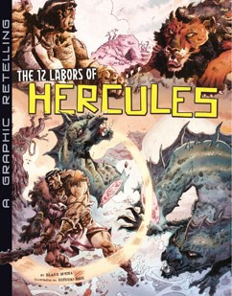
#9
What Dewey category does this book go in?
900-999
History/Geography
200-299
Religion
300-399
Social Sciences

Slide 19
#9
200-299
Religion
Aargh! Click to
select a new question.

Slide 20
#10
What Dewey category does this book go in?
700-799
Arts/Recreation
000-099
General Works
600-699
Technology

Slide 21
#10
700-799
Arts/Recreation
Aargh! Click to
select a new question.

Slide 22
#11
What Dewey category does this book go in?
300-399
Social Sciences
92/921
Biography
400-499
Languages

Slide 23
#11
92/921
Biography
Aargh! Click to
select a new question.

Slide 24
#12
What Dewey category does this book go in?
100-199
Philosophy
800-899
Literature
700-799
Arts/Recreation

Slide 25
#12
700-799
Arts/Recreation
Aargh! Click to
select a new question.

Slide 26
#13
What Dewey category does this book go in?
600-699
Technology
100-199
Philosophy
300-399
Social Sciences

Slide 27
#13
600-699
Technology
Aargh! Click to
select a new question.

Slide 28
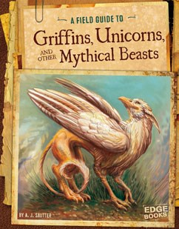
#14
What Dewey category does this book go in?
500-599
Science
000-099
General Works
900-999
History/Geography

Slide 29
#14
000-099
General Works
Aargh! Click to
select a new question.

Slide 30
#15
What Dewey category does this book go in?
400-499
Language
100-199
Philosophy
900-999
History/Geography

Slide 31
#15
900-999
History/Geography
Aargh! Click to
select a new question.

Slide 32
#16
What Dewey category does this book go in?
400-499
Language
300-399
Social Sciences
500-599
Science

Slide 33
#16
300-399
Social Sciences
Aargh! Click to
select a new question.

Slide 34
#17
What Dewey category does this book go in?
600-699
Technology
400-499
Languages
000-099
General Works

Slide 35
#17
600-699
Technology
Aargh! Click to
select a new question.

Slide 36
#18
What Dewey category does this book go in?
600-699
Technology
800-899
Literature
300-399
Social Sciences

Slide 37
#18
300-399
Social Sciences
Aargh! Click to
select a new question.

